Slide 1

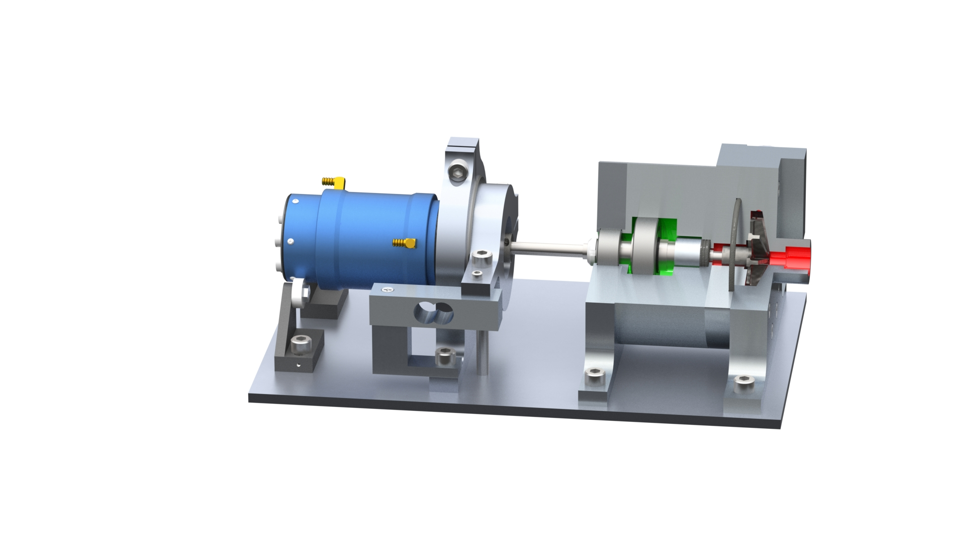
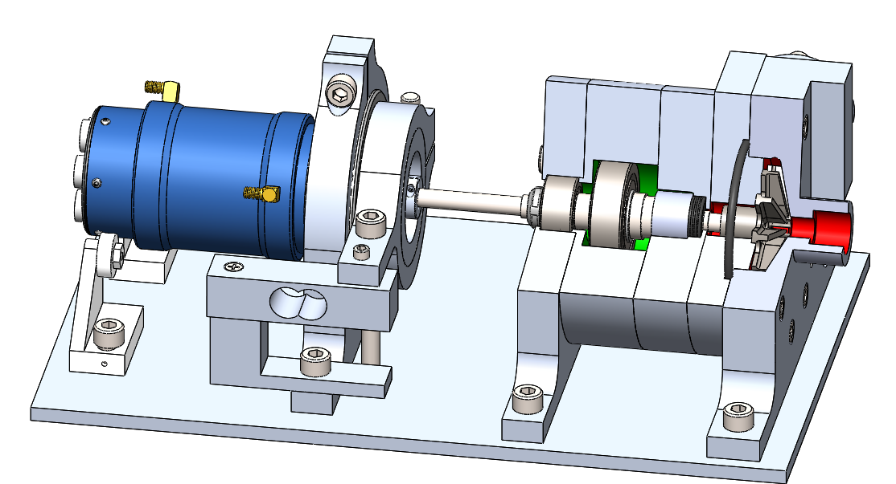
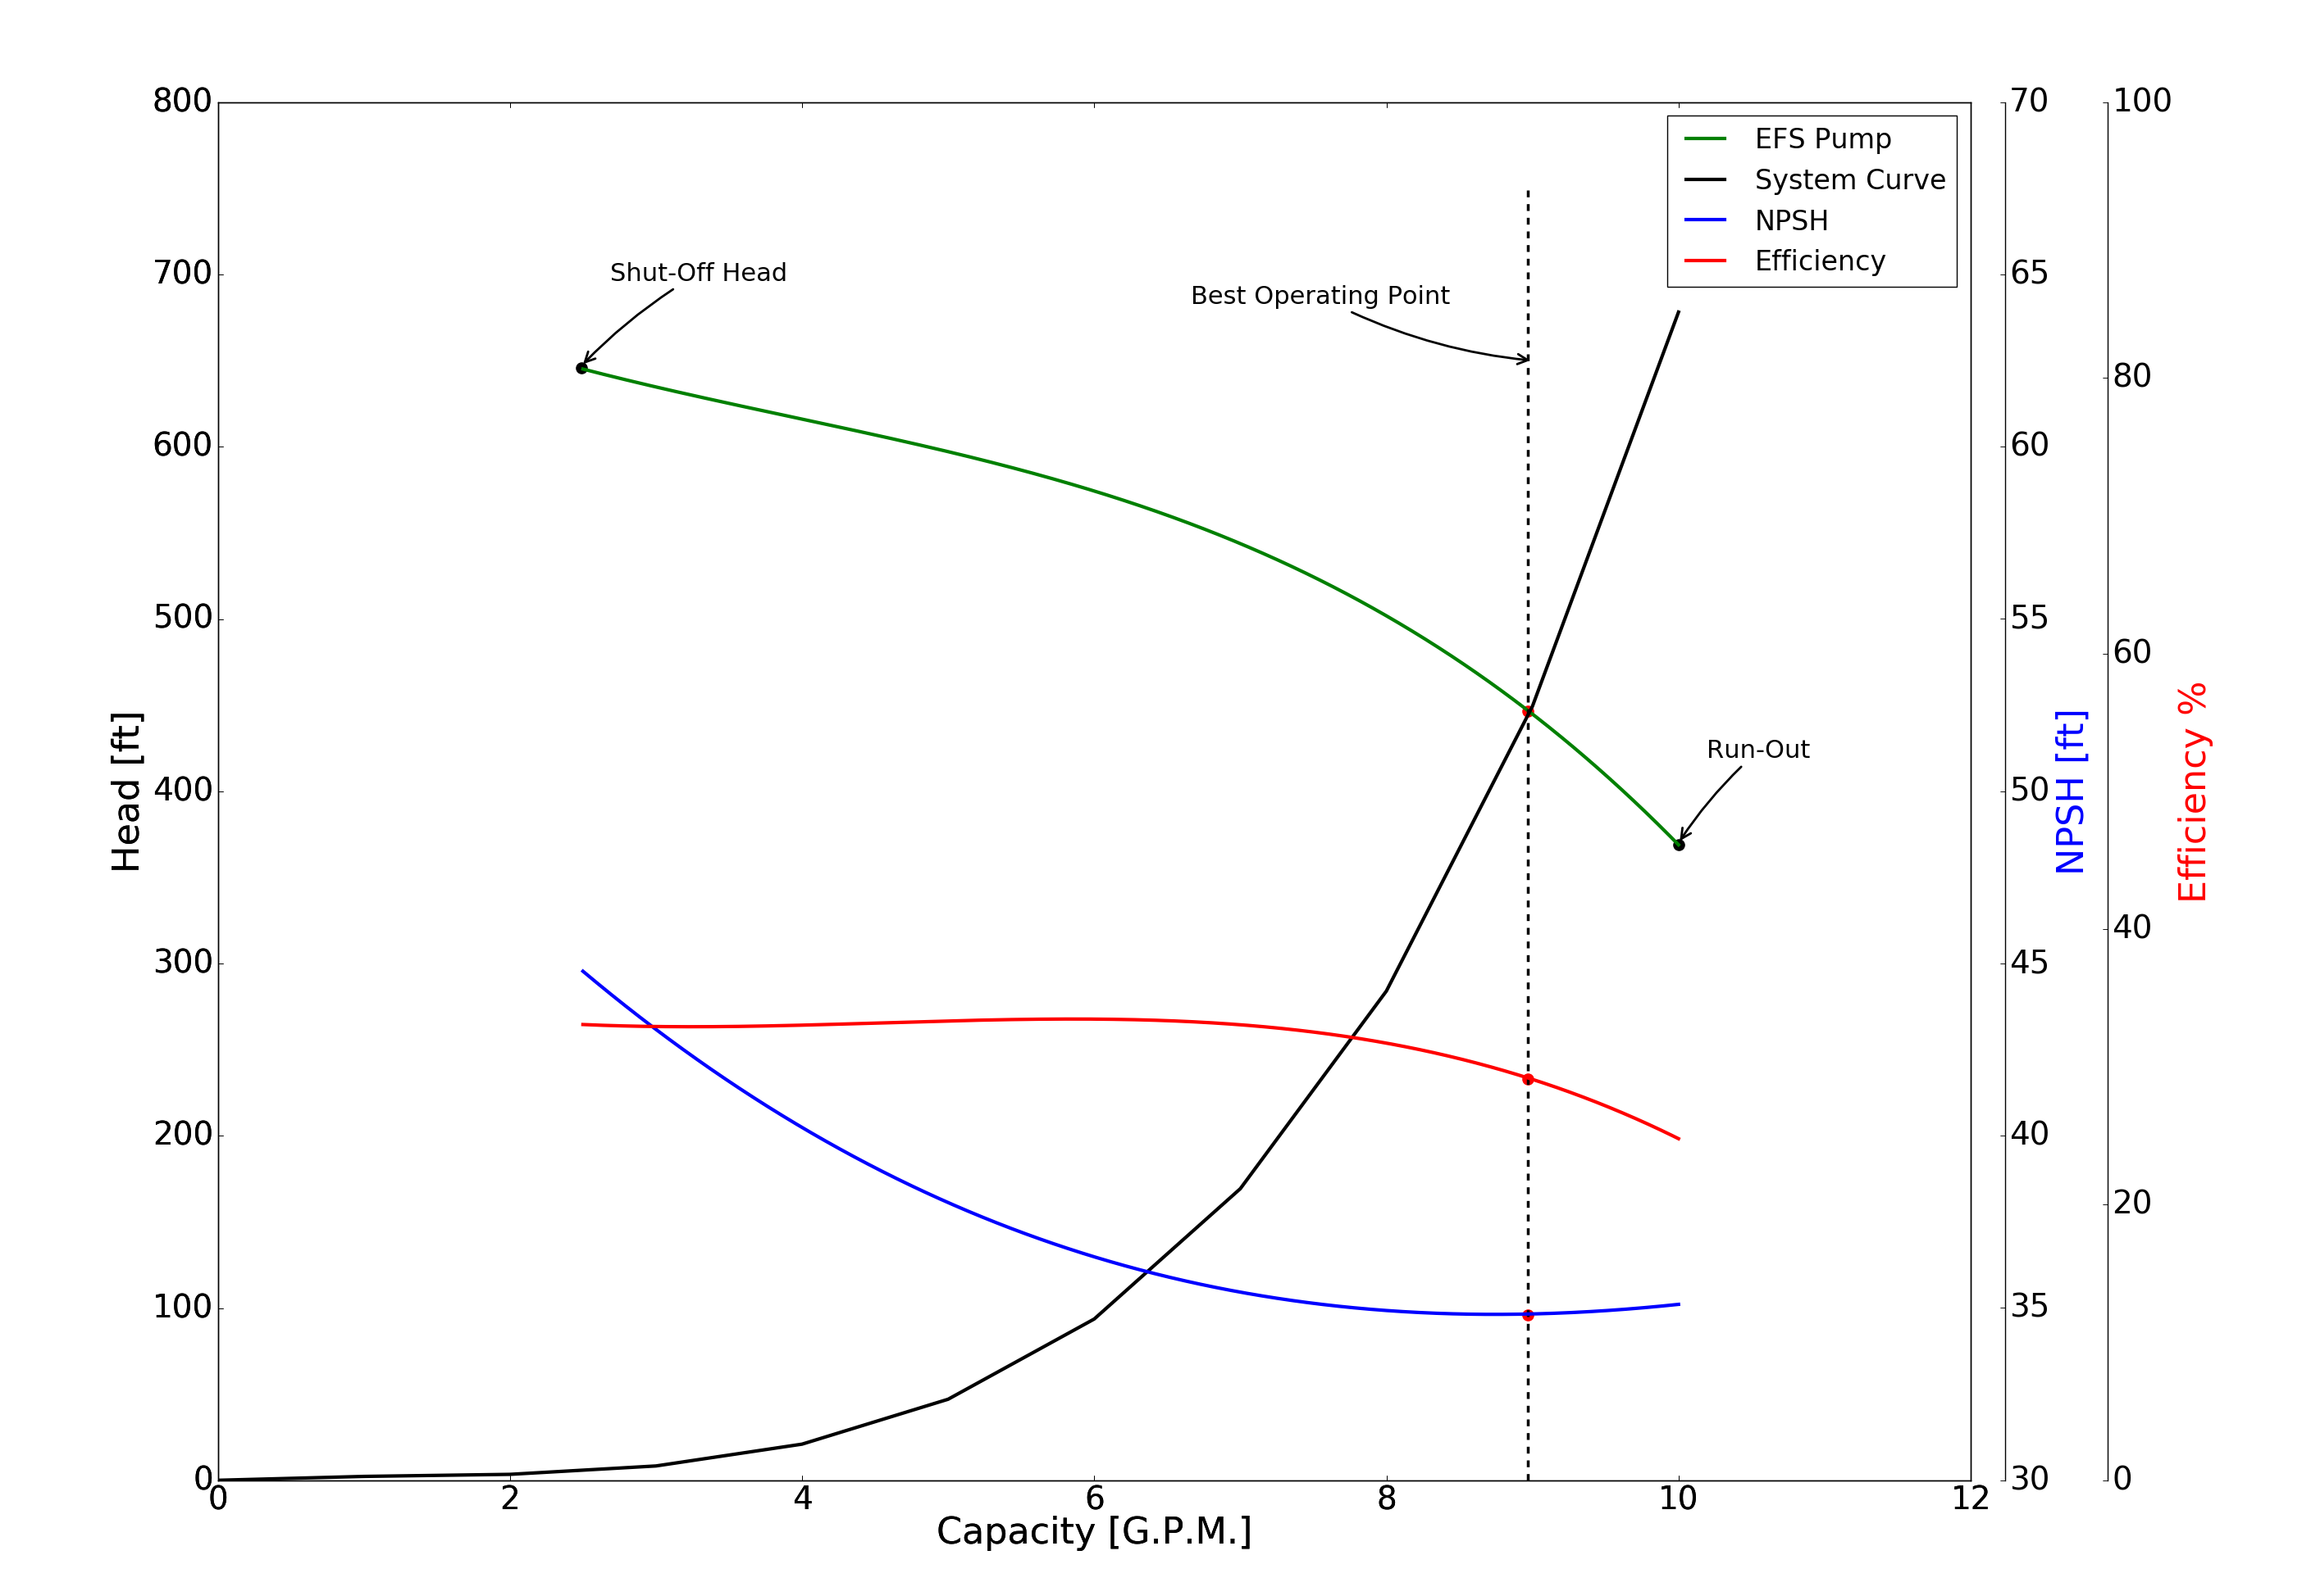
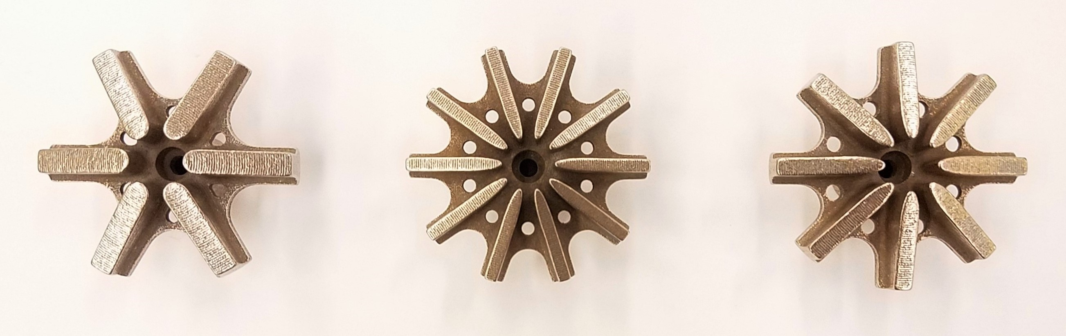
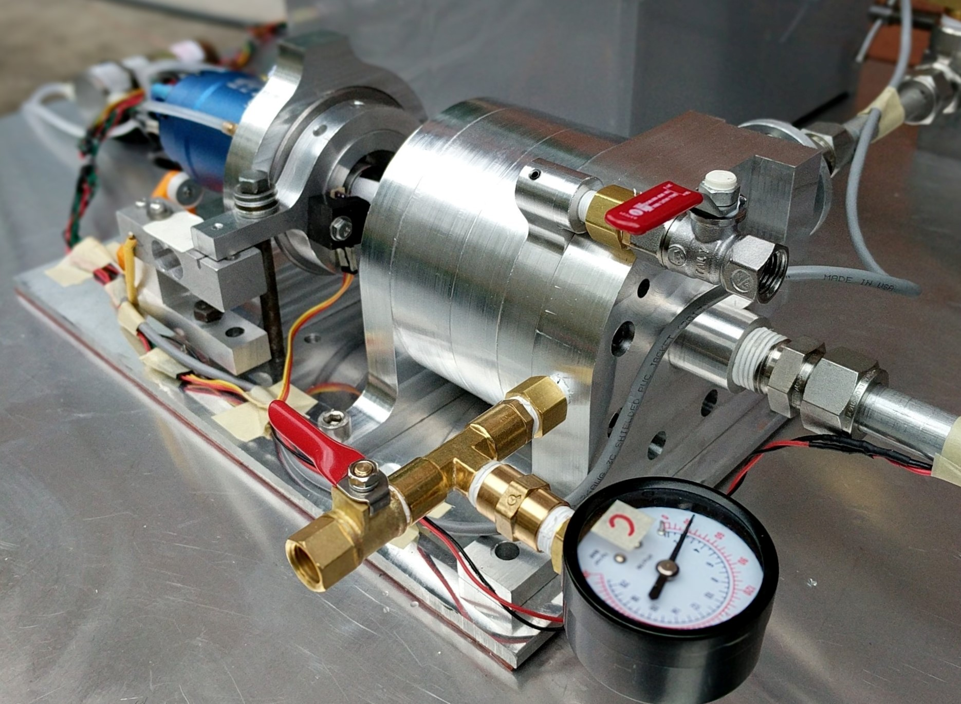
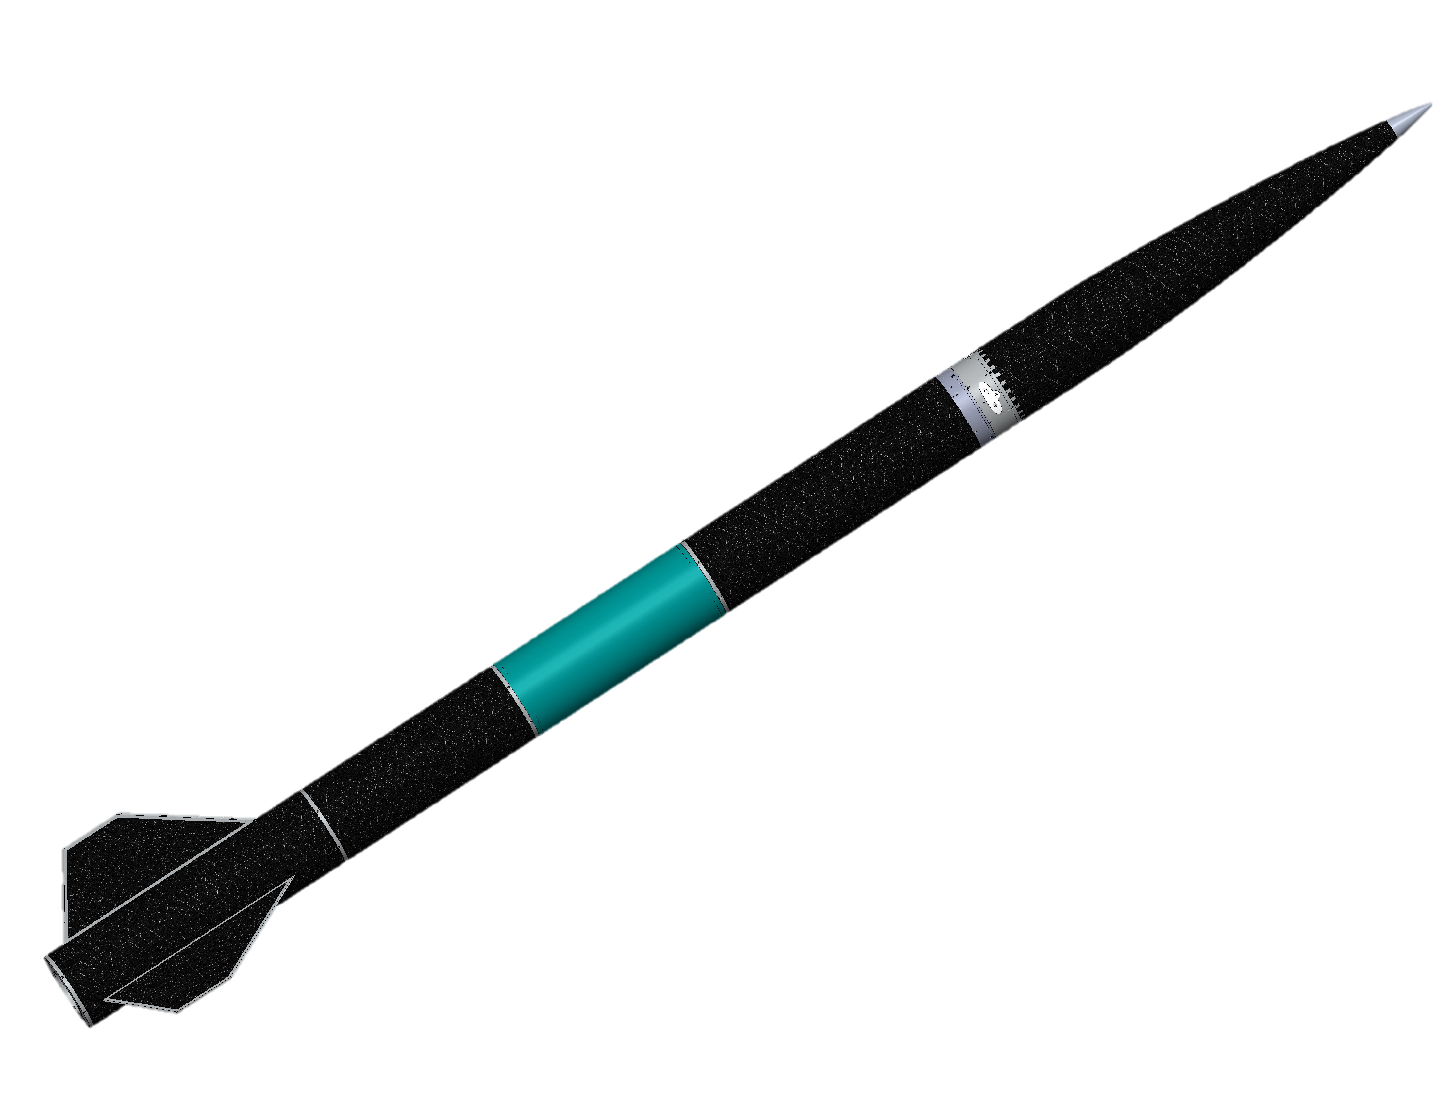
Electric Propellant Feed System (EFS)
Team Members: John C. Froehlich, Jonathan Talik, James Luce, Rawand Rasheed, Mimi Shang and Jordan Roland
Sponsor: Portland State Aerospace Society
Project Objective Statement
The goal of the EFS project is to design, build, and test an electric propellant feed system for the PSAS LV4 liquid fueled bi-propellant rocket engine prototype by June 6, 2017.
Design Features
Measured Performance
The electric feed system is actively being tested over a wide range of operating conditions. Initial feedback at lower rotational speeds has provided promising results. A plot of the system running at 17,500 rpm is shown below.
The system curve is a function of the static head and the major and minor losses in the system. This curve gives the amount of energy the pump has to create up in order to operate at a flowrate.
The pump performance curve describes the relation between the flowrate and head produced by the actual pump.
The best operating point is defined as the flow at which the EFS system operates at the highest or optimum efficiency for a given impeller diameter.
The shut-off (SO) is the head a pump will develop when operating against a closed discharge valve (Q = 0). SO kept at 4 GPM to extend life of pump during testing.
The run-out (RO) is the maximum flow the pump can produce before experiencing severe performance drops.
The NPSH curve shows the minimum amount of suction pressure to overcome pump entrance losses and cavitation.
Water cooled 240 amp brushless DC motor
Floating motor mount
Modular diffuser mount
Barske straight blade impeller
Motivation
Historically, the systems to impel propellants to the combustion chamber of a liquid fueled rocket are based on the employment of turbo-pumps or pressurized gas systems. The complexity and cost of these methods has made building a liquid fuel rocket financially and technically difficult for the amateur rocketry community.
The EFS team is investigating the open source development of a low-cost electric powered alternative for providing the pressure and flow requirements of PSAS’s LV3 rocket.
Key Customer Requirements
Design, build and test a technology development platform for the electronic propellant feed system.
Design a pump capable of delivering 350 psi of pressure at 11 GPM to the LV3 engine.
Pump performance characterization.
Scalable design for future pump iterations.
Open source documentation, design artifacts and build information.
Load cell for live shaft torque measurement
Thrust and radial load bearings
Shaft seal and Rulon bushing
O-ring seal
Inlet eye
Figure 2: EFS performance characteristics at 17,500 rpm using 11 blade impeller and 8 diffuser.
Impellers
The EFS system uses an unorthodox Barske straight blade impeller to meet the unusually high head, low flow engine requirements. Final designs were 3D Printed in stainless steel.
Future Work
Investigate additional design variations.
Test pump with pintle injector.
Adapt system for cryogenic propellant conditions.
Scale for LV4 and future 8kN engine design.
Refine motor control and motor data acquisition.
Experimental Test Platform
Arduino microcontroller used for motor control and system data acquisition.
Variables monitored: Suction pressure, discharge pressure, volute and seal cavity pressures, RPM, flow rate, inlet temperature and shaft torque.
Constant inlet pressure (~45 psi) is provided via a 42 gallon water tank.
Flow is controlled during testing using a gate valve on the discharge side.
Motor and speed controller require water cooling .
Acknowledgments
We thank our mentors Erin Schmidt, Andrew Greenberg and Raúl Bayoán Cal for their support, Chris Auclair for sharing a wealth of MasterCam knowledge, Haneef Mubarak for lending a valuable hand, and Mike Chung for allowing us to live in his machine shop. Funding for this project was provided by Portland State Aerospace Society
Project Website
https://github.com/psas/electric-feed-system
Figure 1: PSAS Launch Vehicle-3 (LV3) CAD model.

